Slide 1
Web Frontend Architecture
Wen Ke
2019.03.09

Slide 2
Agenda
Which Framework to Choose
Business Requirments Solutions
Frontend Architecture Diagram
Project File Structure
Testing
Code-Splitting and Optimizing Performance
Error Monitoring
Tracking and Logging User Interactions
CI/CD

Slide 3
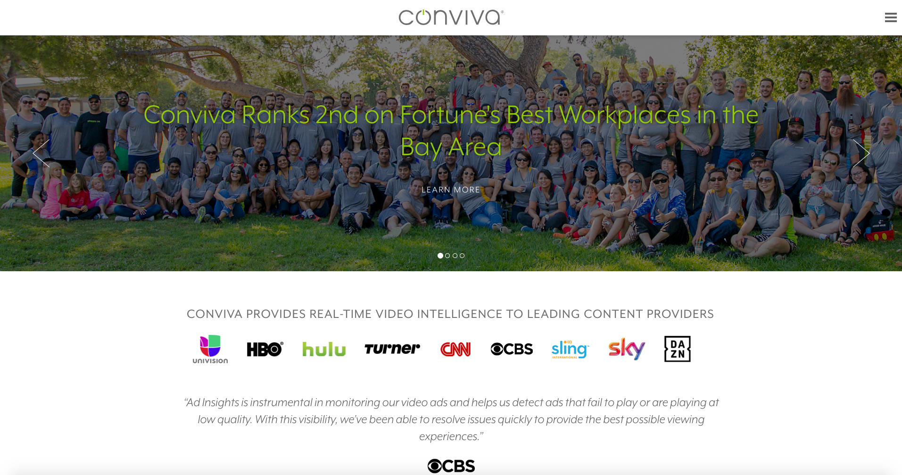
Notes:
Conviva是一家基于人工智能的视频分析技术开发商，由Hui Zhang和Ion Stoica创建，其实时大数据平台是基于卡内基梅隆和伯克利大学的科研成果，为互联网视频收视体验的实时监测和优化领域的开创者和领跑者。
Conviva是世界上最早实现视频播放自适应的视频分发平台之一：支持100多种视频播放客户端，25亿台不同的视频播放设备，每月50亿次视频播放，每秒3百万实时监测数据处理。
在此平台上孵化出的Spark现已成为大数据产业的基石之一。
现在公司基于多年视频播放和用户观看行为数据的收集，已跻身于世界上最大的视频观看数据平台行列，从而为给更多客户提供智能、个性化服务创造了独特的优势。

Slide 4
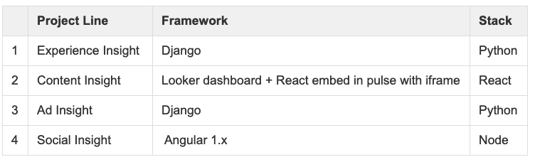
Which Framework to Choose
Current Situation & Problems

Slide 5
Which Framework to Choose
Angular vs Vue vs React: Which Framework to Choose in 2019
"The answer to the debate of Angular vs Vue vs React is that there’s no absolute right choice." the author says, "Each of these libraries has their own benefits and drawbacks. Based on the project you’re working on, and your individual requirements, one of them is going to be more suitable than the others."
Notes:
"The answer to the debate of Angular vs Vue vs React is that there’s no absolute right choice." the author says, "Each of these libraries has their own benefits and drawbacks. Based on the project you’re working on, and your individual requirements, one of them is going to be more suitable than the others."
The conclusion is totally right. For a real engineer, there is no substantial difference which framework to choose, because it just takes some time to get used to the new one. It is common that vertically divided product line use different frameworks, especially when each product line has fully resources, which means they do not need to share engineers.
But different frameworks has a big problem: re-build wheels from scratch. Each product line can not share codes with the others. That is a big waste of time and human-resources for company.
We have the agreement that we need to provide a unified view for each product and highly consistent experience already, which means we should choose one framework for all of our 4 product lines.
The principles are:
we want to pick something that not only people are using at successful companies, but also something that is growing and not diminishing as a trend.
we want to have a strong community with good documentation and resources
we want to use a tool that we will enjoy working with.

Slide 6
Which Framework to Choose
we want to pick something that not only people are using at successful companies, but also something that is growing and not diminishing as a trend.
we want to have a strong community with good documentation and resources
we want to use a tool that we will enjoy working with.
Notes:
The principles are:
we want to pick something that not only people are using at successful companies, but also something that is growing and not diminishing as a trend.
we want to have a strong community with good documentation and resources
we want to use a tool that we will enjoy working with.
人的因素
框架是否有坑(vue主要focus在移动端)

Slide 7
Which Framework to Choose
React
Notes:
"The answer to the debate of Angular vs Vue vs React is that there’s no absolute right choice." the author says, "Each of these libraries has their own benefits and drawbacks. Based on the project you’re working on, and your individual requirements, one of them is going to be more suitable than the others."
The conclusion is totally right. For a real engineer, there is no substantial difference which framework to choose, because it just takes some time to get used to the new one. It is common that vertically divided product line use different frameworks, especially when each product line has fully resources, which means they do not need to share engineers.
But different frameworks has a big problem: re-build wheels from scratch. Each product line can not share codes with the others. That is a big waste of time and human-resources for company.
We have the agreement that we need to provide a unified view for each product and highly consistent experience already, which means we should choose one framework for all of our 4 product lines.
The principles are:
we want to pick something that not only people are using at successful companies, but also something that is growing and not diminishing as a trend.
we want to have a strong community with good documentation and resources
we want to use a tool that we will enjoy working with.

Slide 8
Business Requirments Solutions
Component Library
Multi Languages
Custom Themes
Responsive Layout(pc/phone)
Notes:
- Component Library
storybook and react-styleguidist
- Multi Languages
react-intl and react-i18next and react-localize-redux
- Custom Theme
react-theme-provider and Theming React Components and CoreUI (React)
- Responsive layout
react-responsive

Slide 9
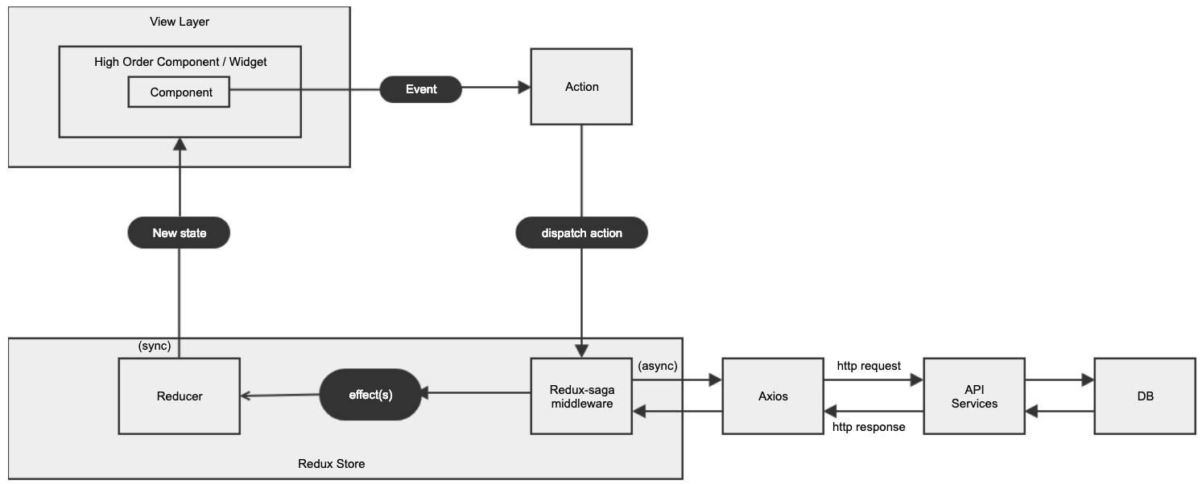
Frontend Architecture Diagram

Slide 10
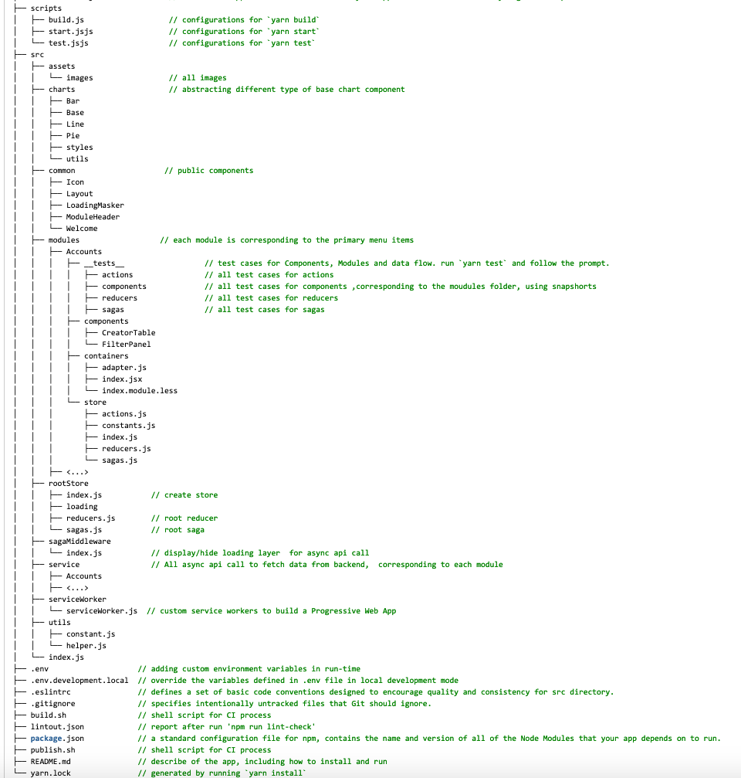
project file structure

Slide 11
Test
What we do not test
Third-party libraries
Constants
Inline styles
Things not related to the tested component.
Notes:
First of all, we shouldn’t test all code, followings are what should be omitted in test coverage:
Third-party libraries. We are not responsible for that code.
Constants. The name speaks for itself. They are not changeable.
Inline styles. In most cases, inline styles don’t change the component’s behaviour, so they shouldn’t be tested. There can be an exception if the styles change dynamically.
Things not related to the tested component. Skip covering with tests components that were imported in the tested component.

Slide 12
Test
What we test
User Interface
Component Logic
- Actions
- Reducers
- Sagas
Notes:
First of all, we shouldn’t test all code, followings are what should be omitted in test coverage:
Third-party libraries. We are not responsible for that code.
Constants. The name speaks for itself. They are not changeable.
Inline styles. In most cases, inline styles don’t change the component’s behaviour, so they shouldn’t be tested. There can be an exception if the styles change dynamically.
Things not related to the tested component. Skip covering with tests components that were imported in the tested component.

Slide 13
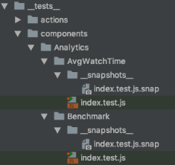
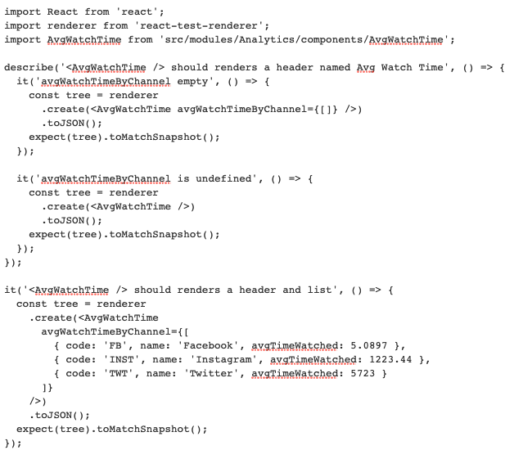
Snapshot Testing
Notes:
Snapshot Testing

Slide 14
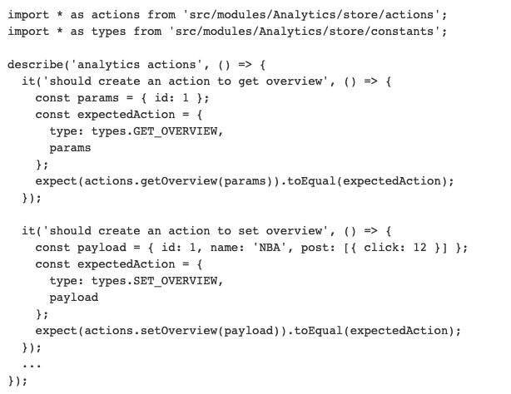
test actions
Notes:
test actions

Slide 15
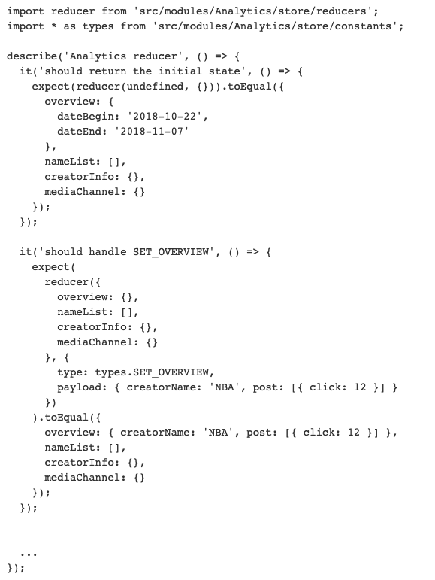
test reducers
Notes:
test reducers

Slide 16
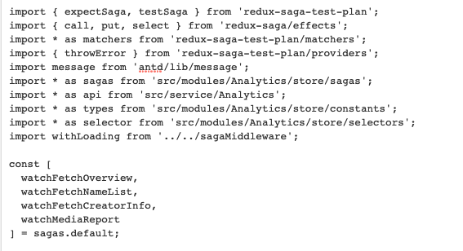
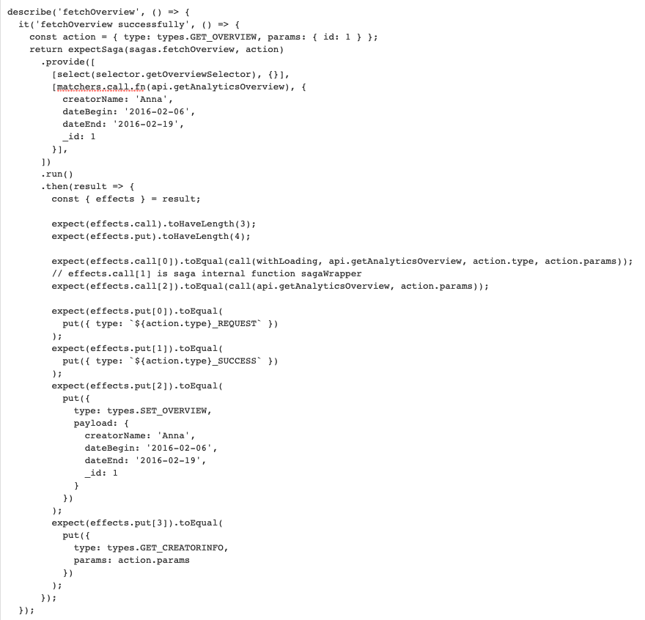
test sagas with
redux-saga-test-plan
Notes:
test sagas with redux-saga-test-plan

Slide 17
Code-Splitting and Optimizing Performance
Code-Splitting
- source map explorer
- webpack bundle analyzer
- webpack visualizer
Optimizing Performance
Notes:
Code-Splitting is a feature supported by bundlers like Webpack which can create multiple bundles that can be dynamically loaded at runtime. Code-splitting your app can help you “lazy-load” just the things that are currently needed by the user, which can dramatically improve the performance of your app. While you haven’t reduced the overall amount of code in your app, you’ve avoided loading code that the user may never need, and reduced the amount of code needed during the initial load.
Optimizing Performance. Internally, React uses several clever techniques to minimize the number of costly DOM operations required to update the UI. For many applications, using React will lead to a fast user interface without doing much work to specifically optimize for performance. Nevertheless, there are several ways you can speed up your React application.

Slide 18
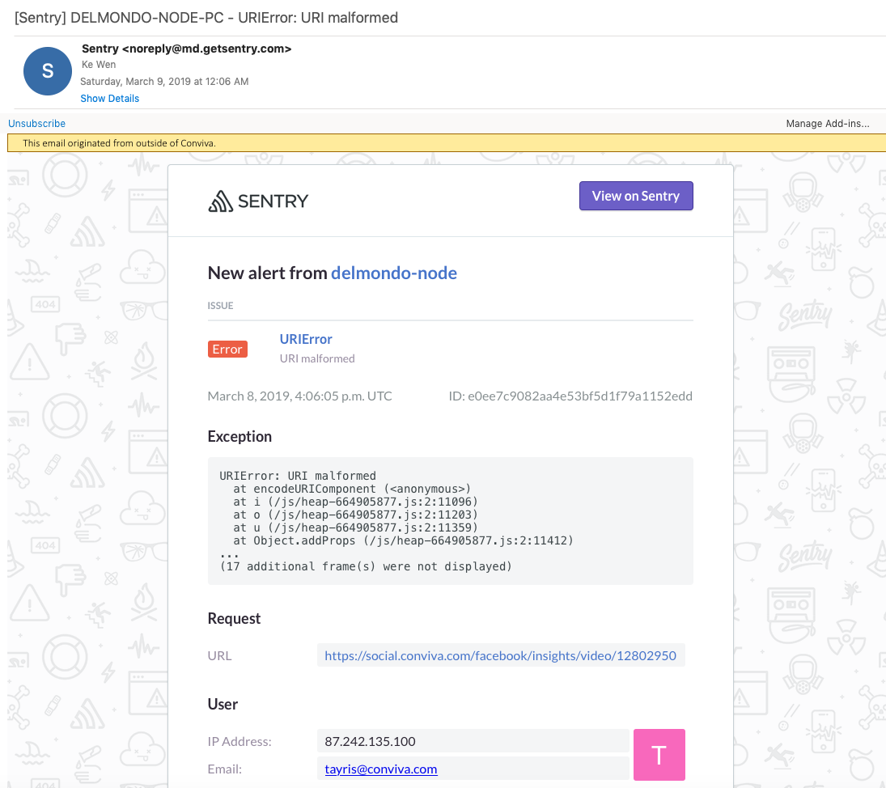
Error Monitoring
Notes:
Sentry is an open-source error tracking tool that helps you monitor and fix crashes in real time.
sentry pricing (delmondo is using the `Team` plan, with Monthly event volume of 1M)
the sentry workflow
sentry error reporting
We can get notifications by email(by default), and also can integrate the notification with Slack.

Slide 19
Tracking and Logging User Interactions
Option 1: Google Analytics
Option 2: Heap Analytics
Option 3: We build a Heap-alike system by ourselves.
Notes:
Option 1: Google Analytics , but it has some problem with SinglePageApplication, which page url wont change.
Option 2: Heap Analytics. Heap automates away the annoying parts of user analytics. No manual event tracking. No messy tracking plans. No custom ETL pipelines. Just insights for everyone on your team. Introduction on Youtube
Option 3: We build a Heap-alike system by ourselves.

Slide 20
CI/CD
build the project
upload the static assets(images/css/js) to the cdn server
update the index.html on the Nginx servers' DocumentRoot (or dockers)
If we add nodes, we need to update the Nginx Load Balancing configuration either.
Notes:
With AWS API Gateway service, step 3/4 is no more needed, which save us a lot of work.

Slide 21
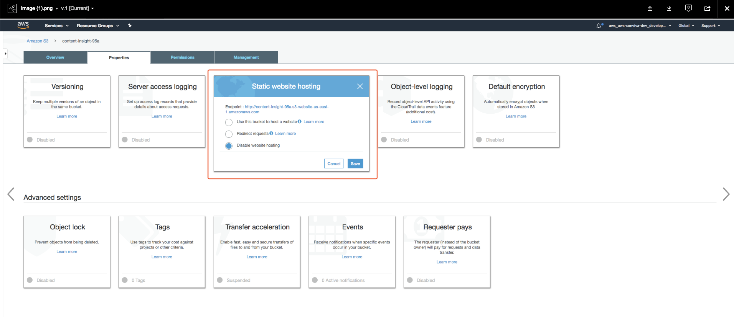
CI/CD
Notes:
1. Build S3 as Static website hosting

Slide 22
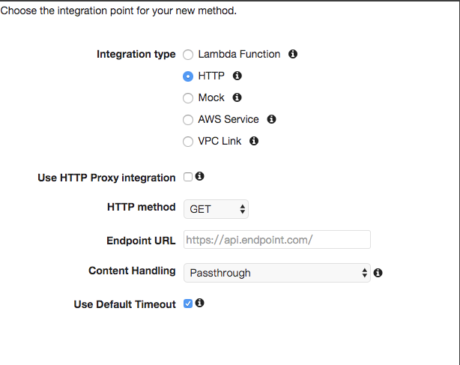
CI/CD
Notes:
2. Config HTTP protocal and Endpoint URL

Slide 23
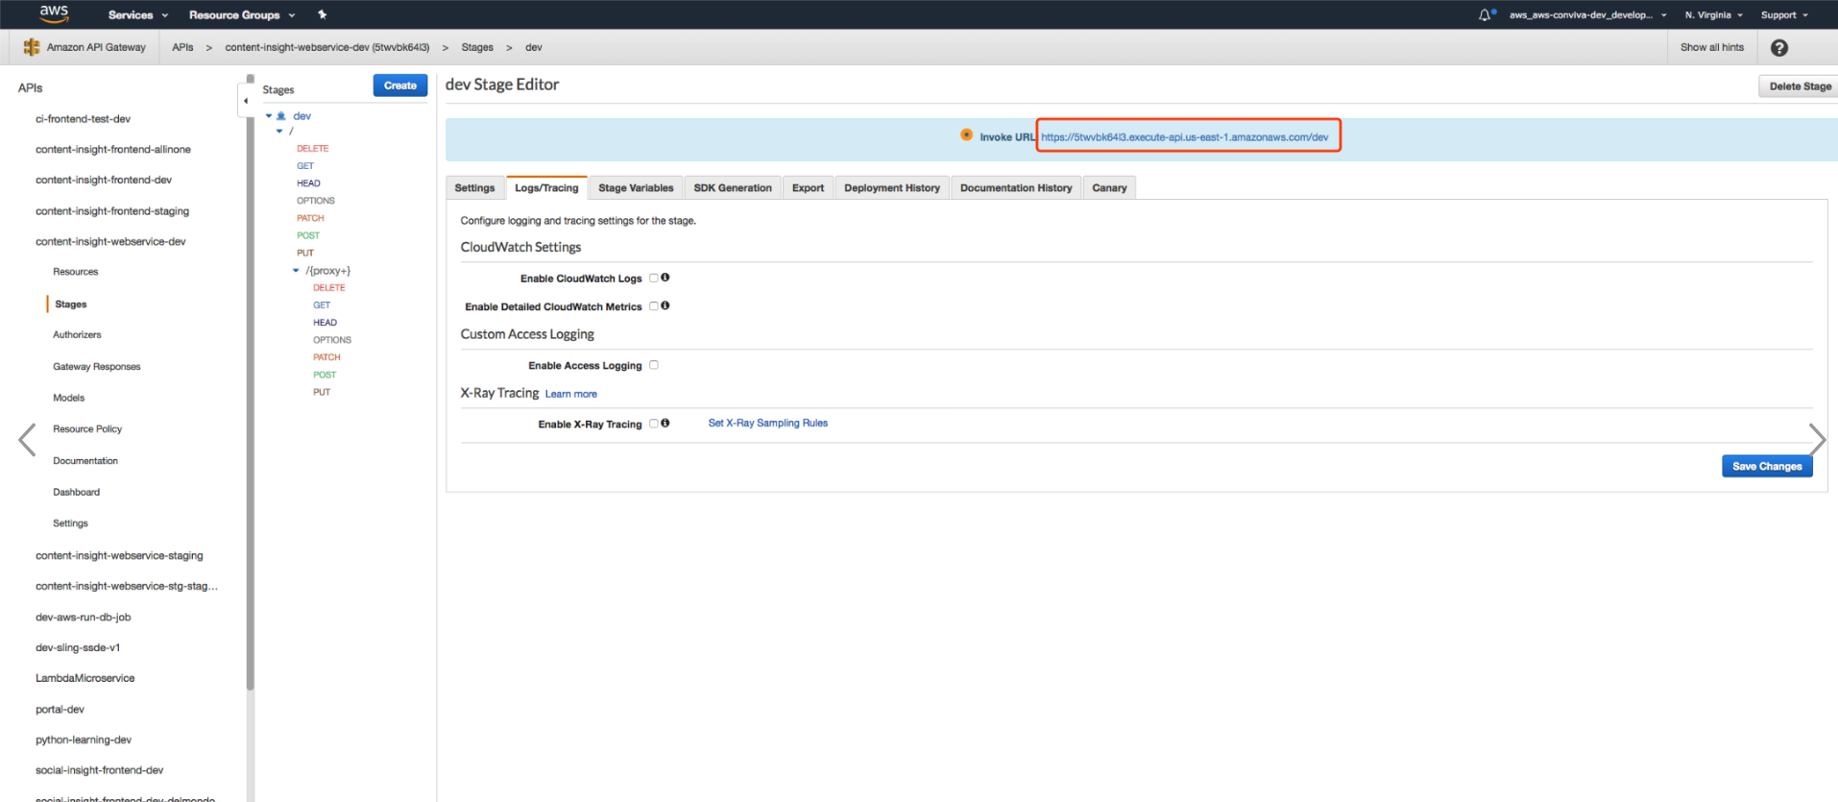
Notes:
3.Config API Gateway, to enable it can be accesed through https

Slide 24
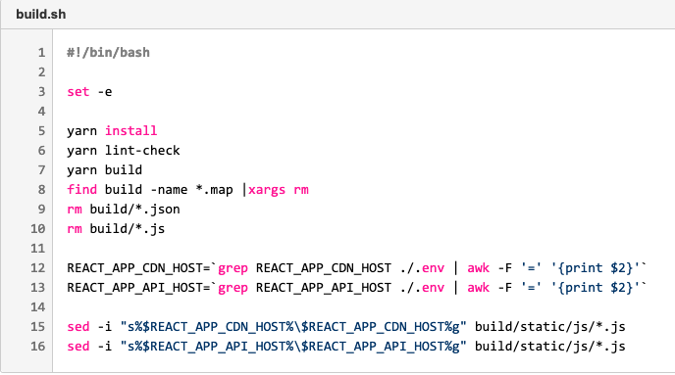
CI/CD
Notes:
The build process is:

Slide 25
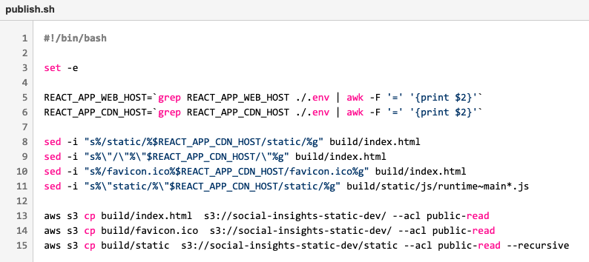
CI/CD
Notes:
The publish process is:

Slide 26

Thank You

